Slide 1
Experiments Results

Slide 2
RobustCbss Scalability

Slide 3

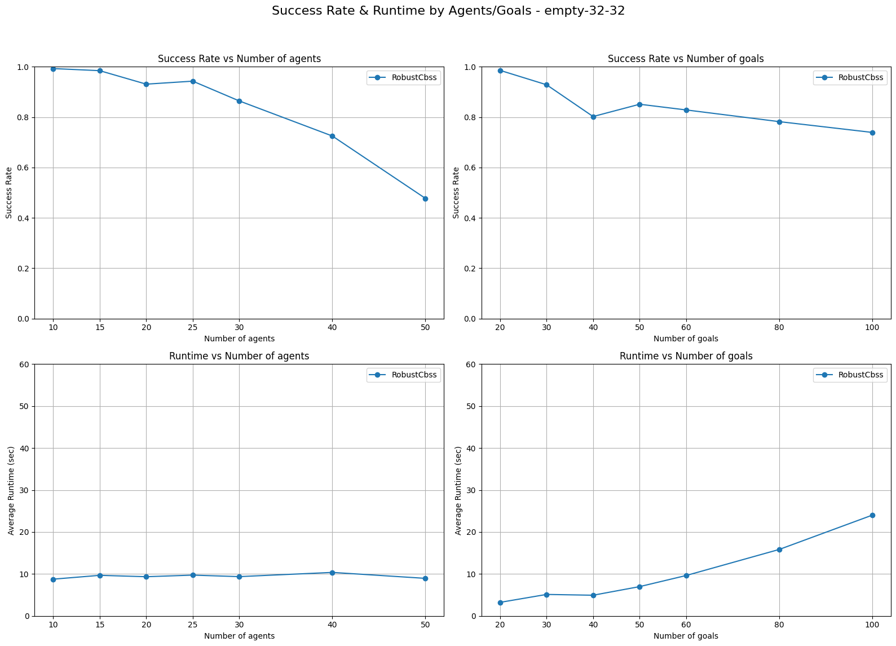
Empty-32-32 32X32

Slide 4
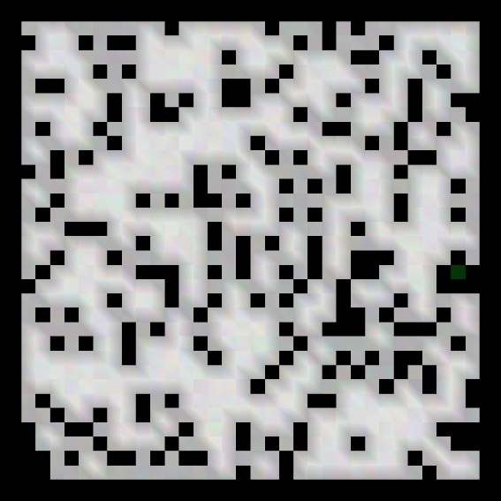
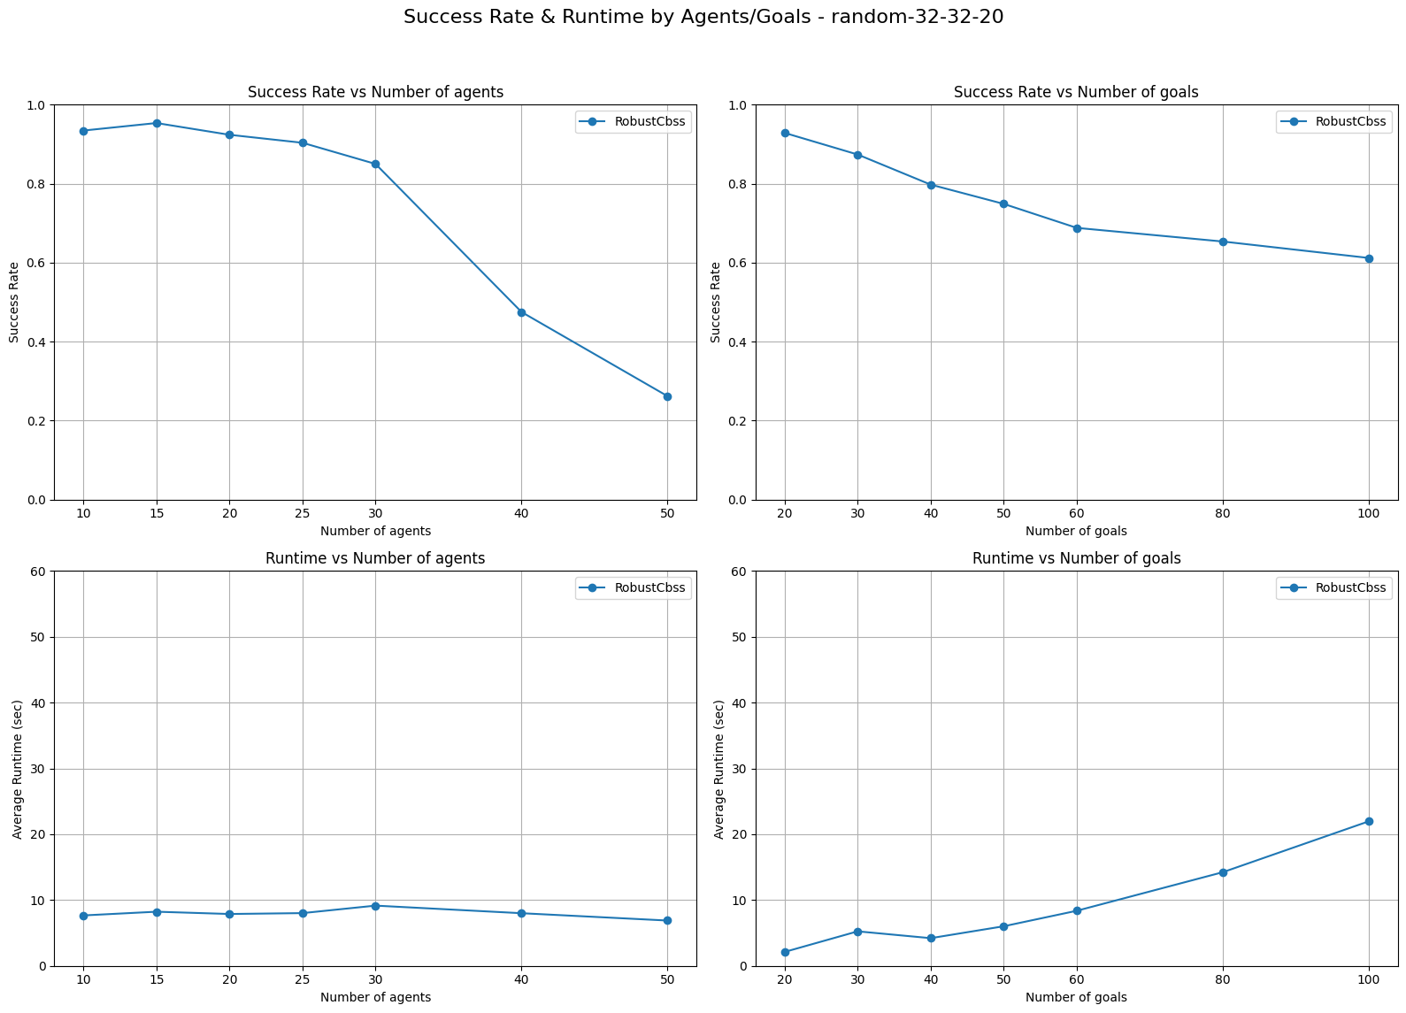
Random-32-32-20 32X32

Slide 5
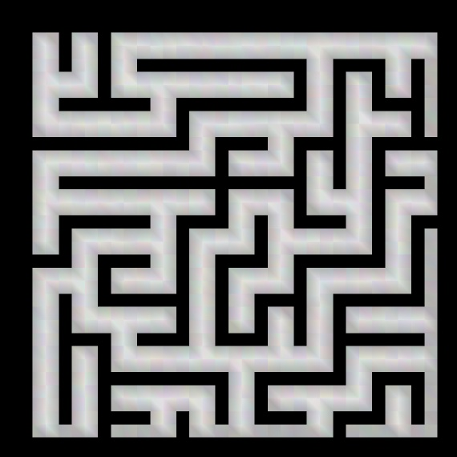
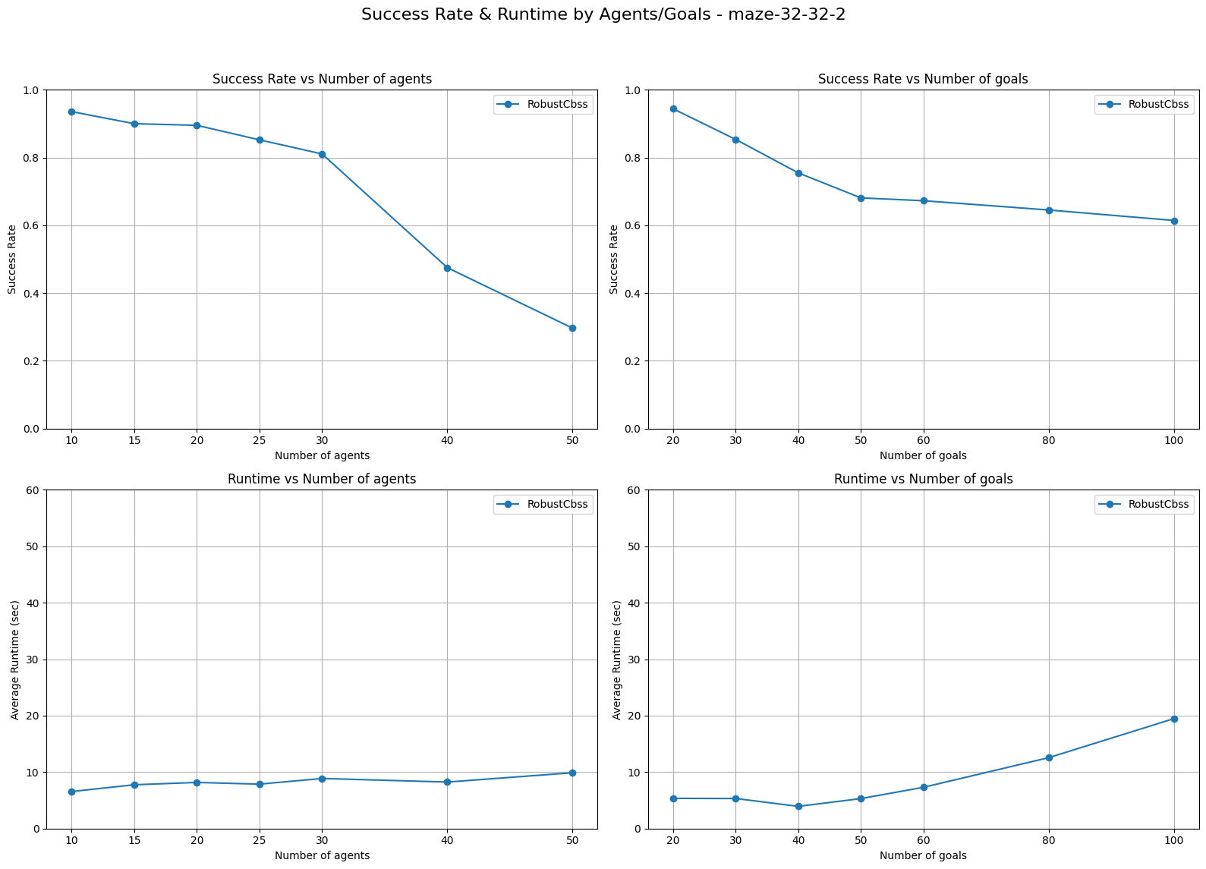
Maze-32-32-2 32X32

Slide 6
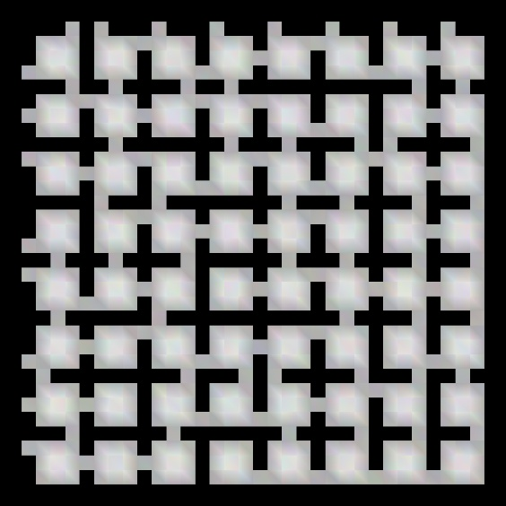
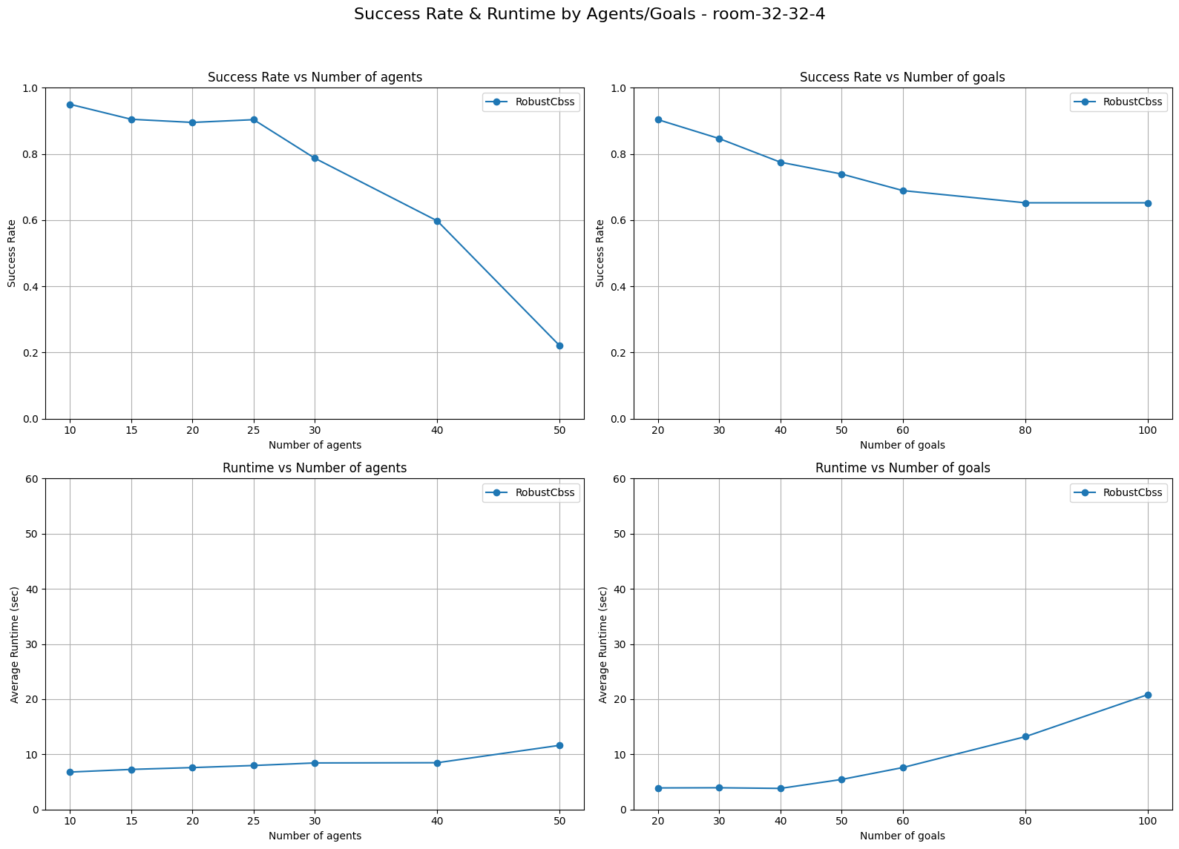
Room-32-32-4 32X32

Slide 7
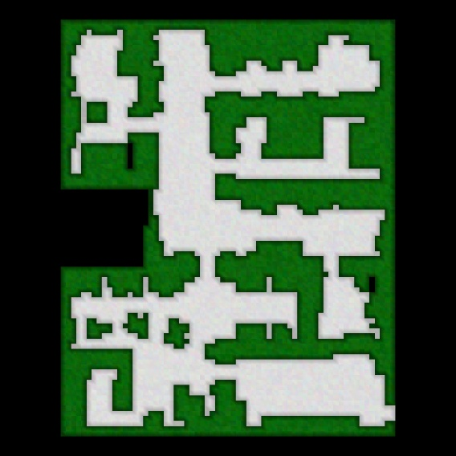
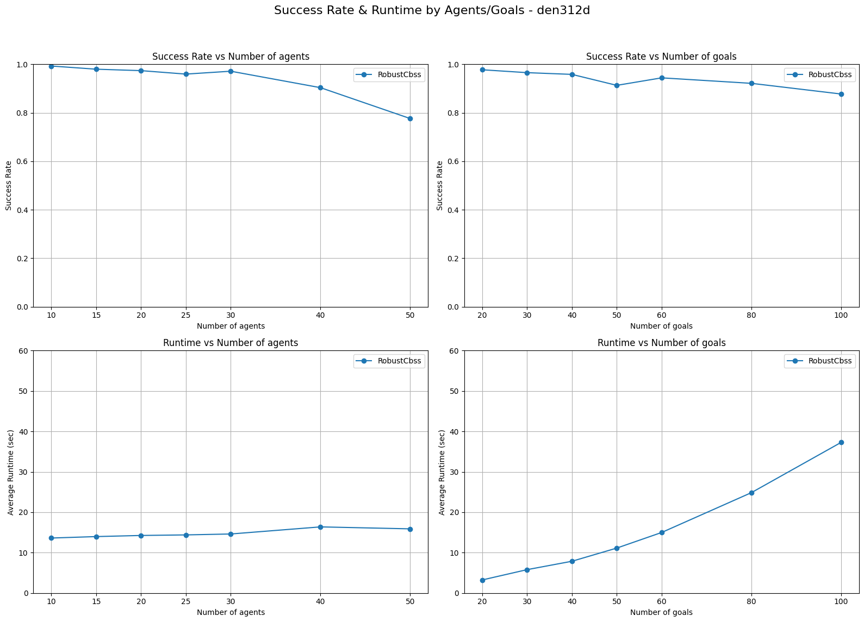
Den312d 81X65

Slide 8
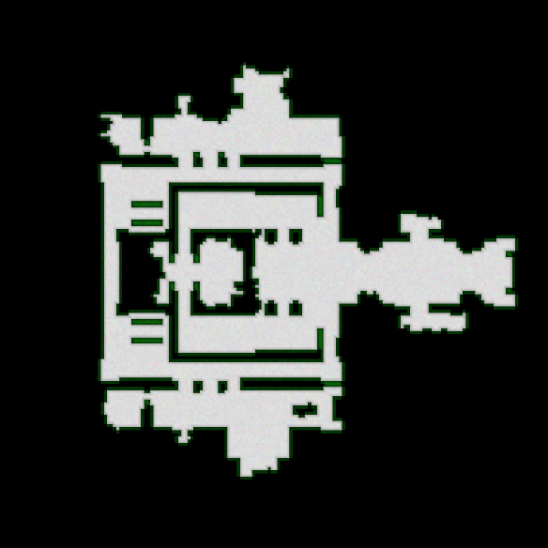
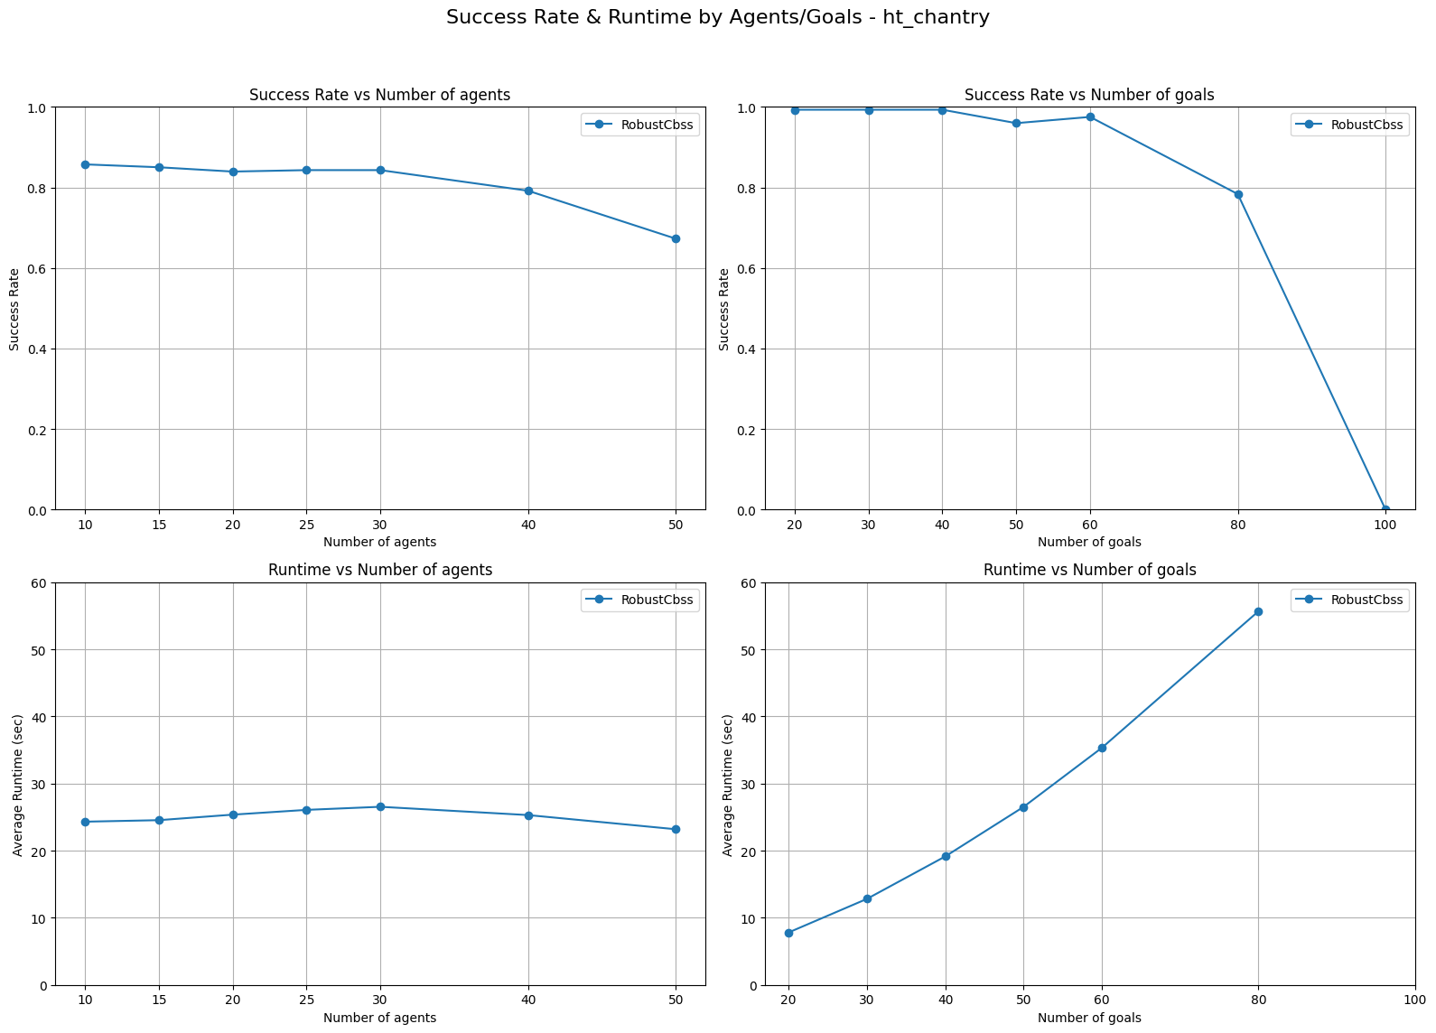
Ht_chantry 141X162

Slide 9
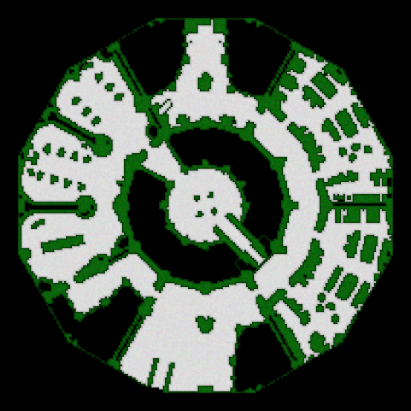
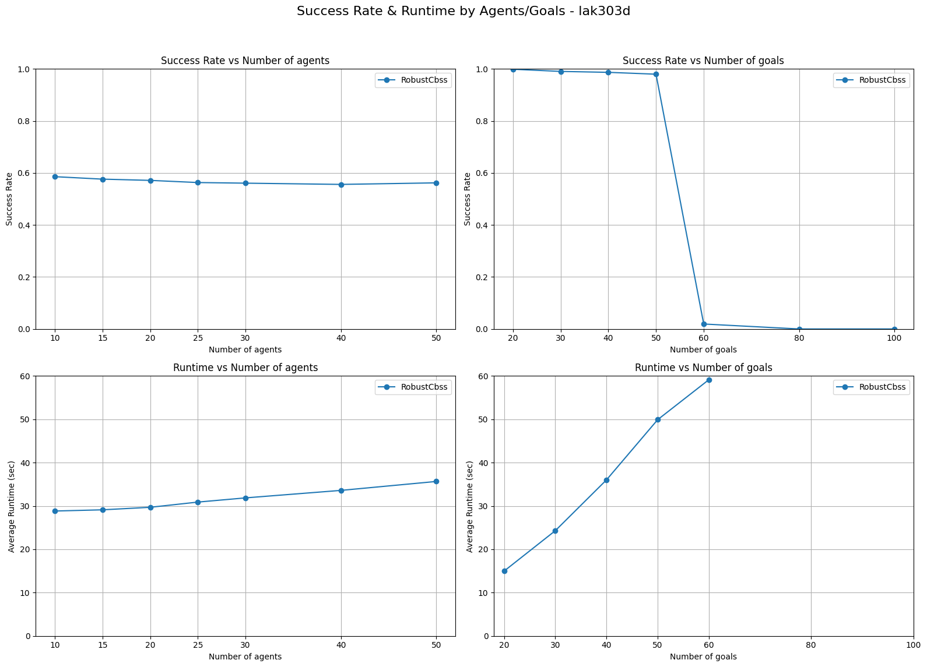
Lak303d 194X194

Slide 10
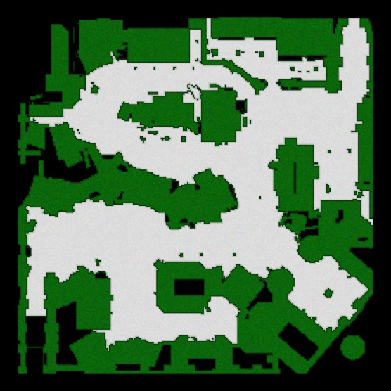
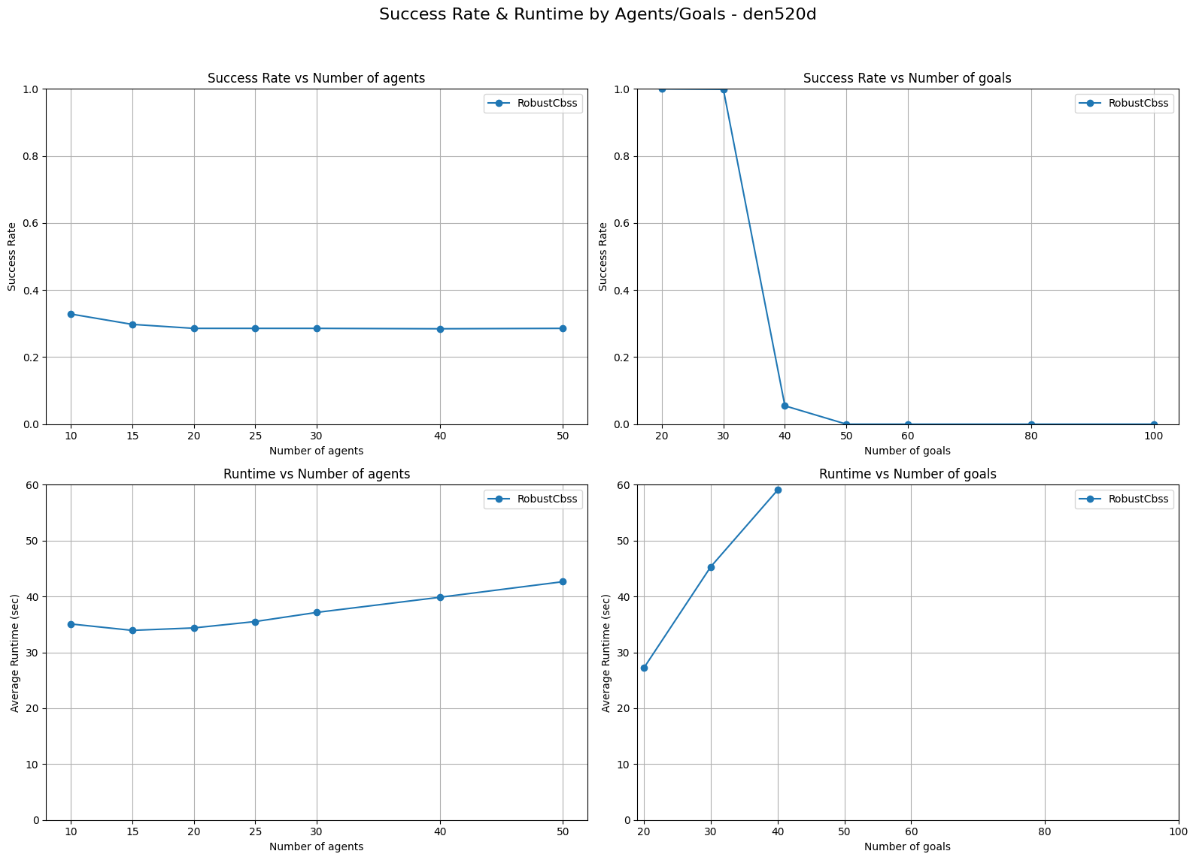
Den520d 257X256

Slide 11
RobustCbss vs. TSPA

Slide 12
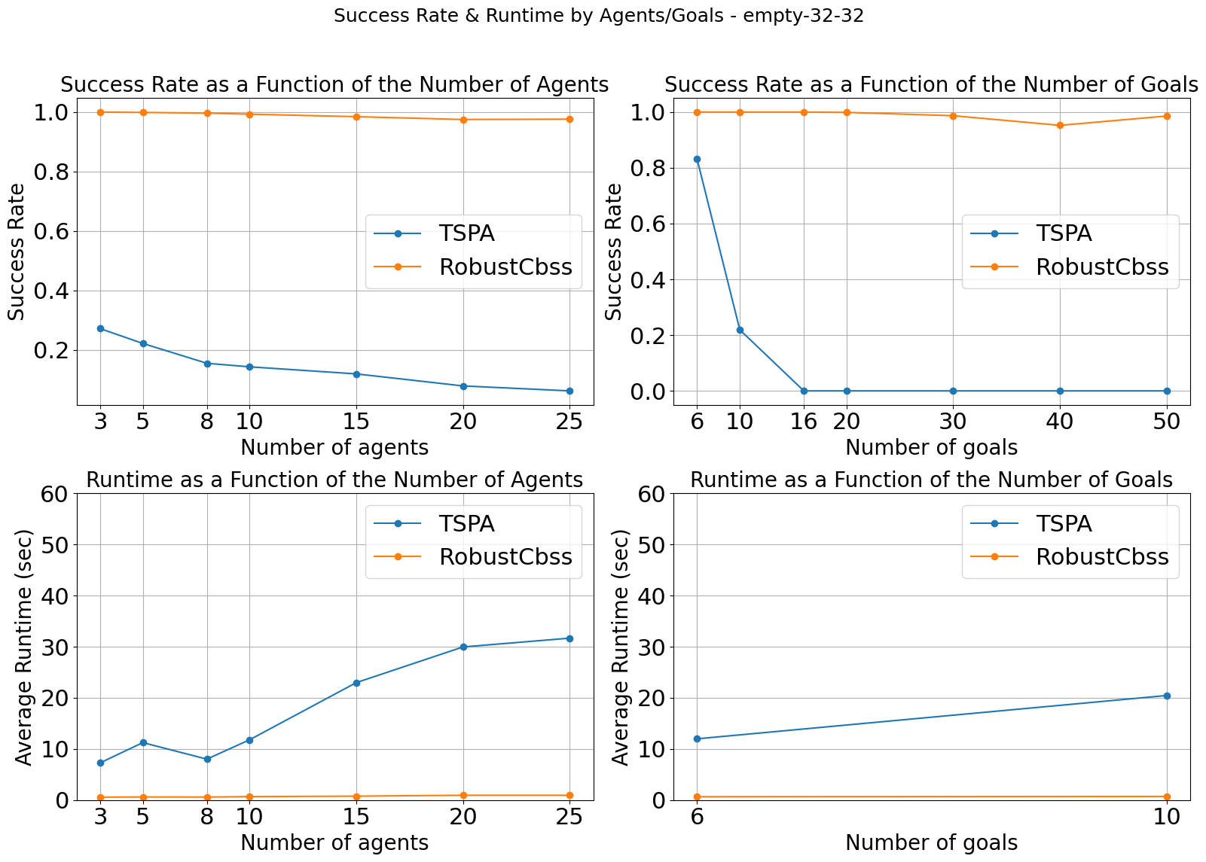
Empty-32-32 32X32

Slide 13
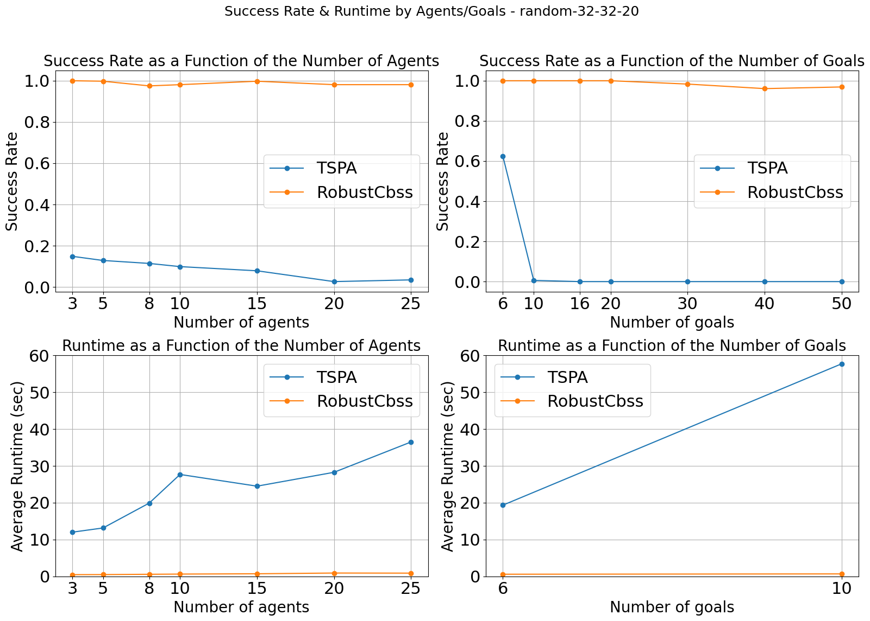
Random-32-32-20 32X32

Slide 14
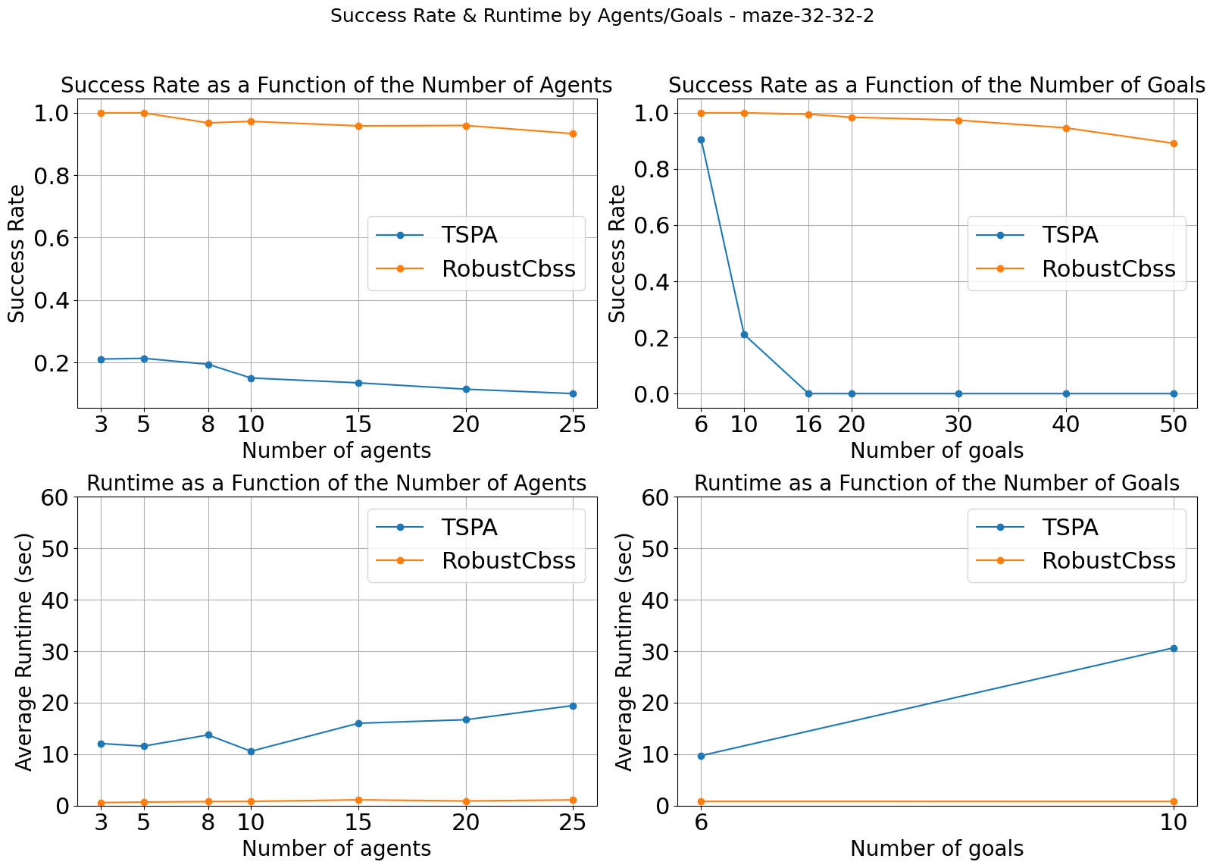
Maze-32-32-2 32X32

Slide 15
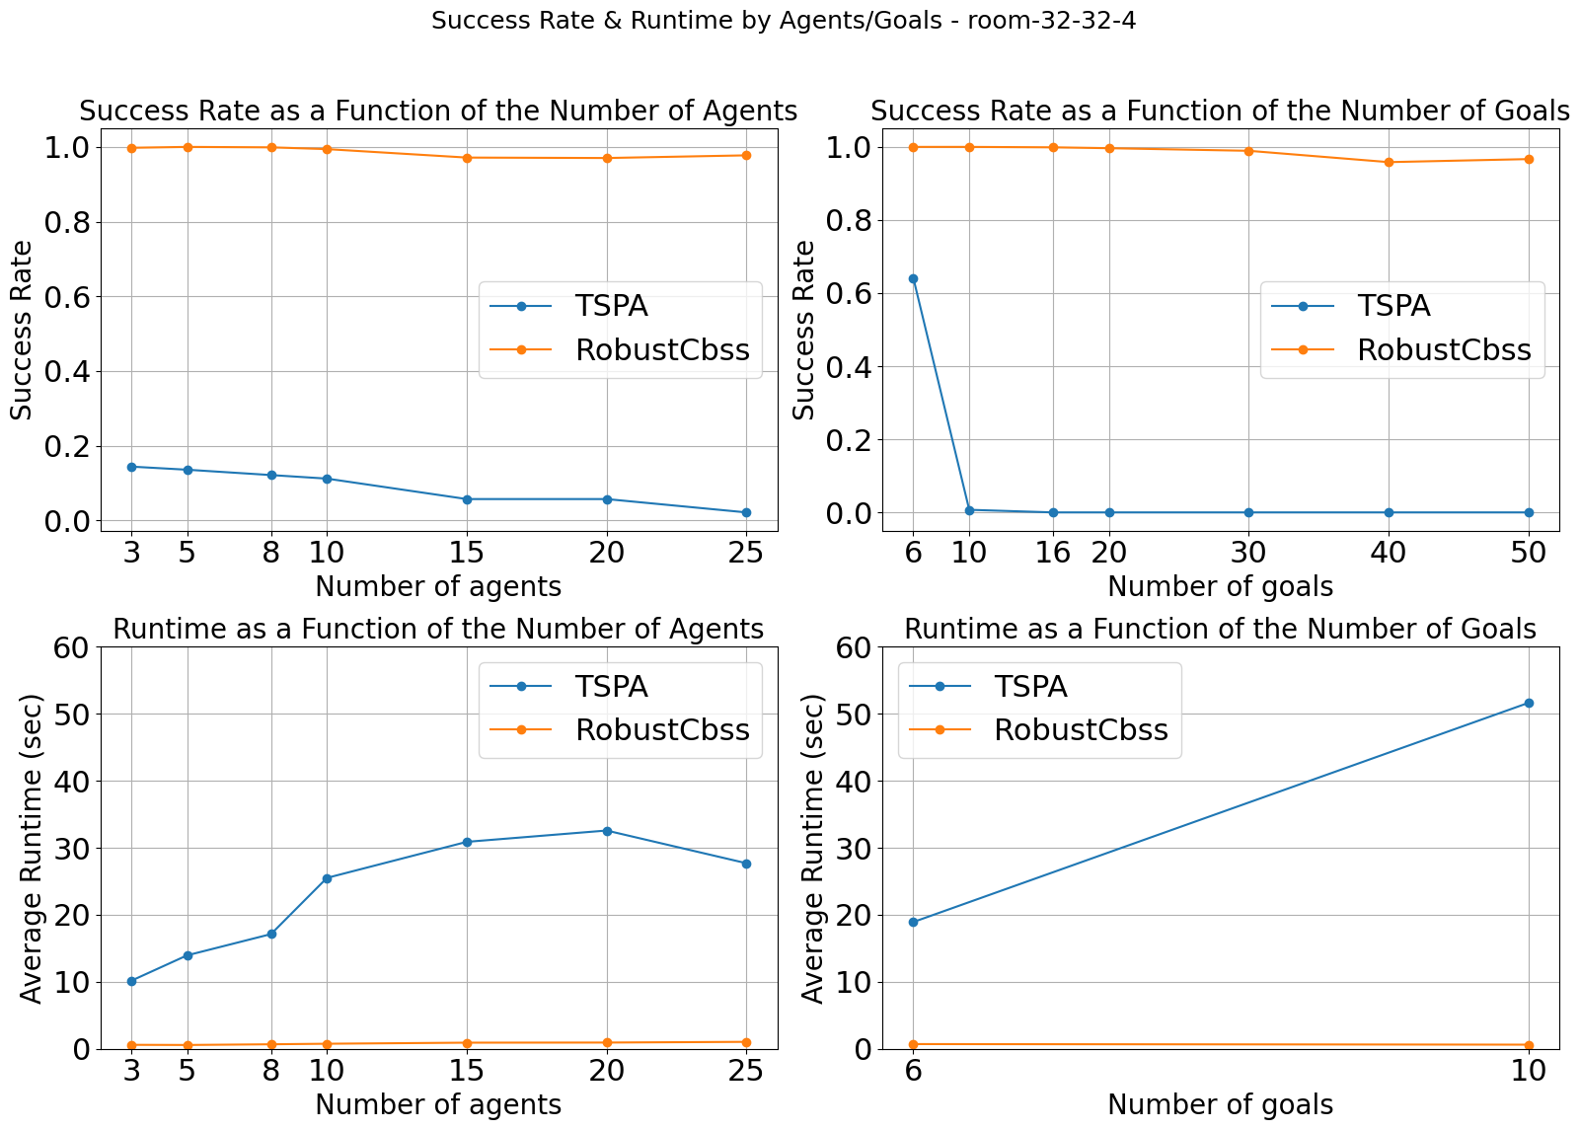
Room-32-32-4 32X32

Slide 16
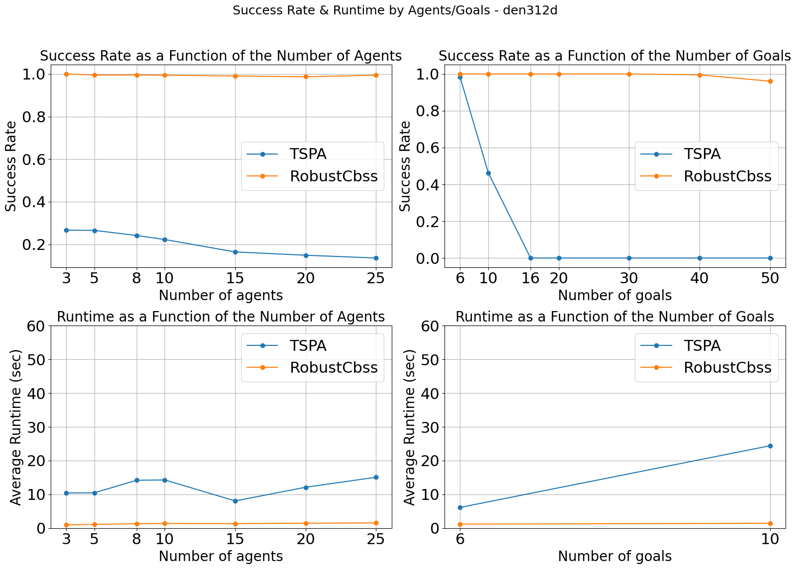
Den312d 81X65

Slide 17
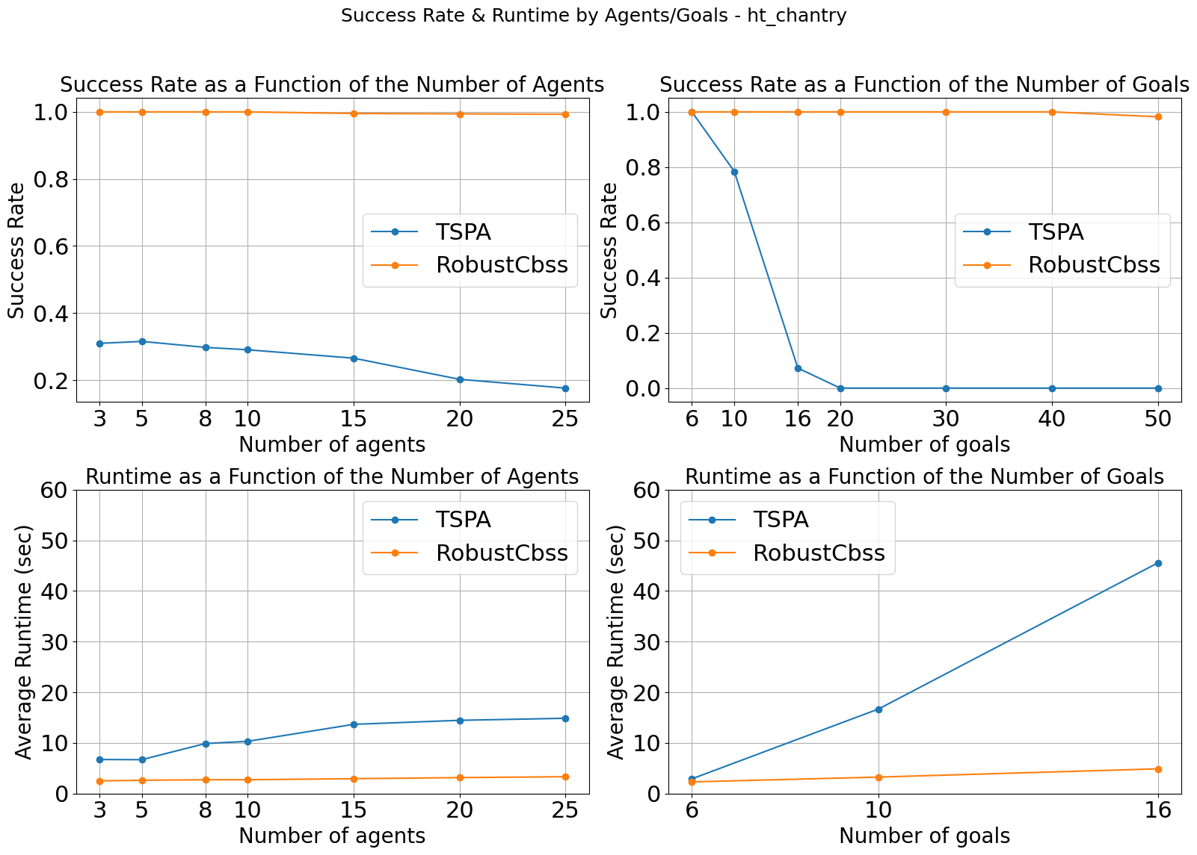
Ht_chantry 141X162

Slide 18
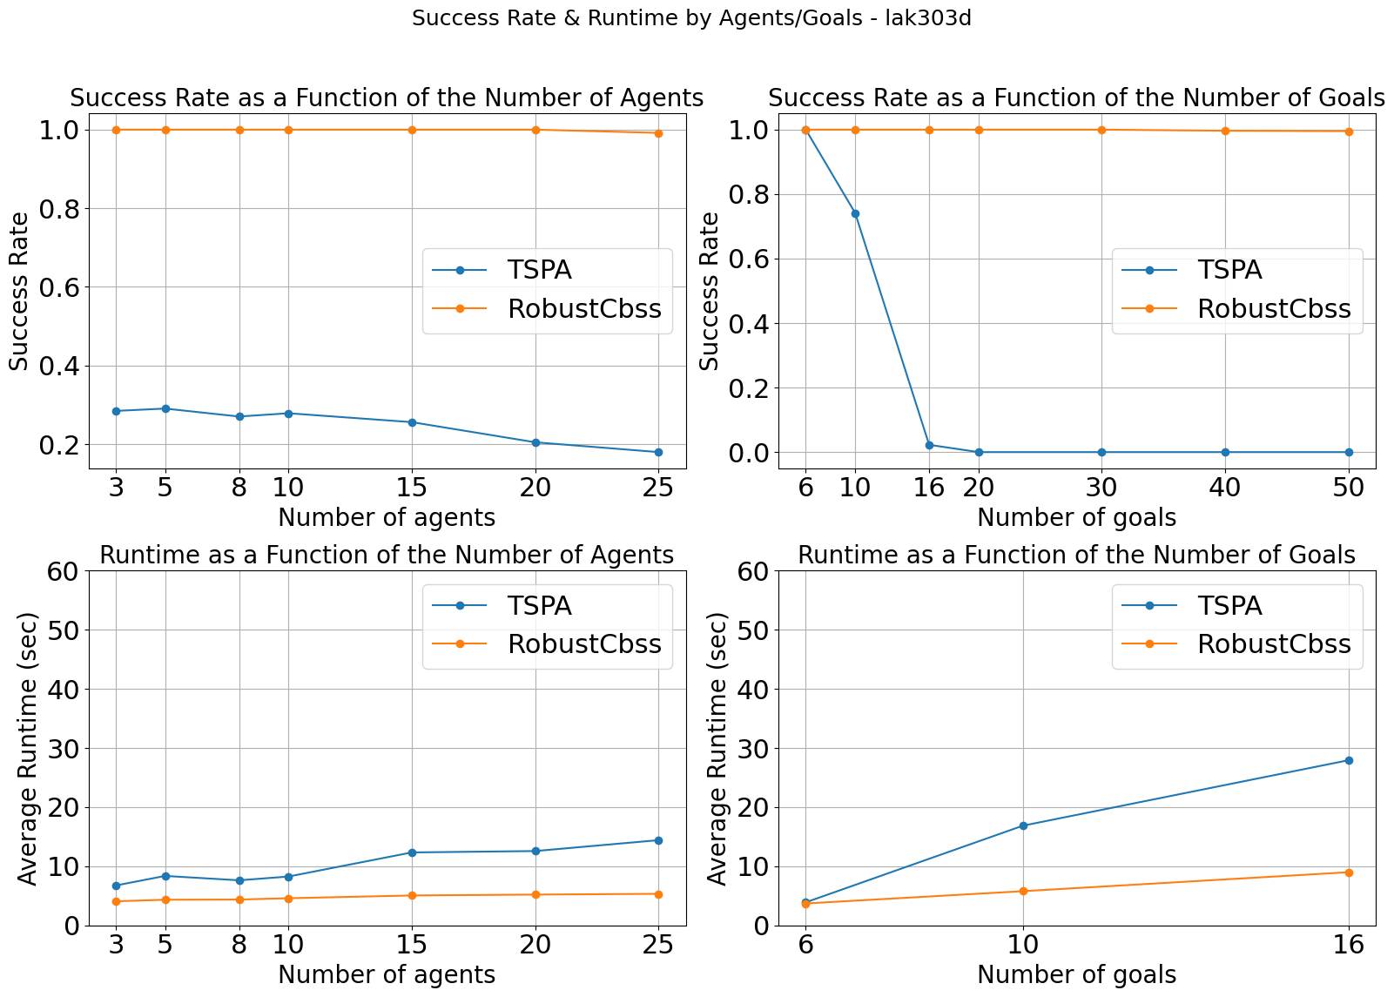
Lak303d 194X194

Slide 19
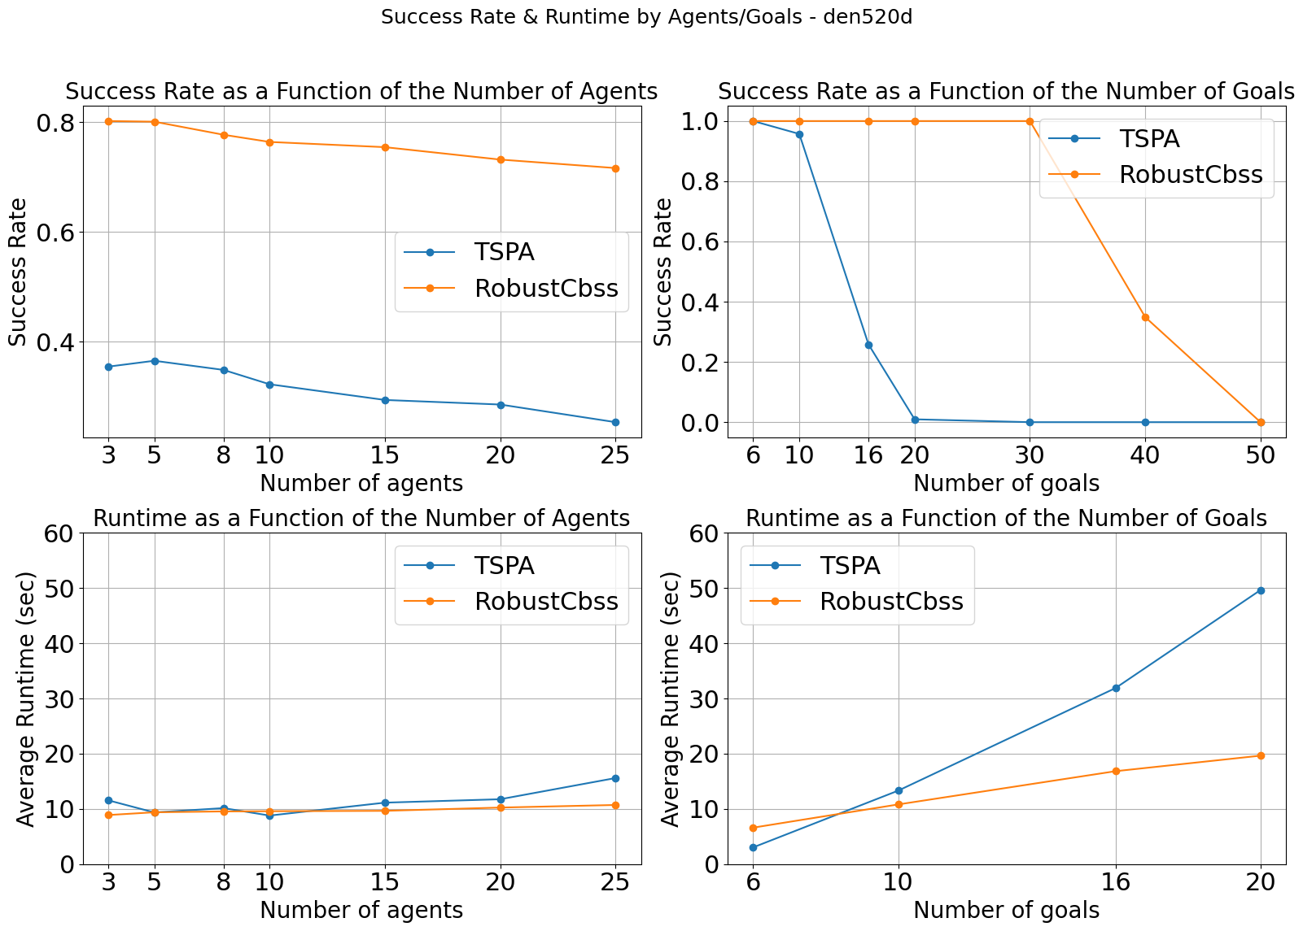
Den520d 257X256

Slide 20
Ablation Study

Slide 21
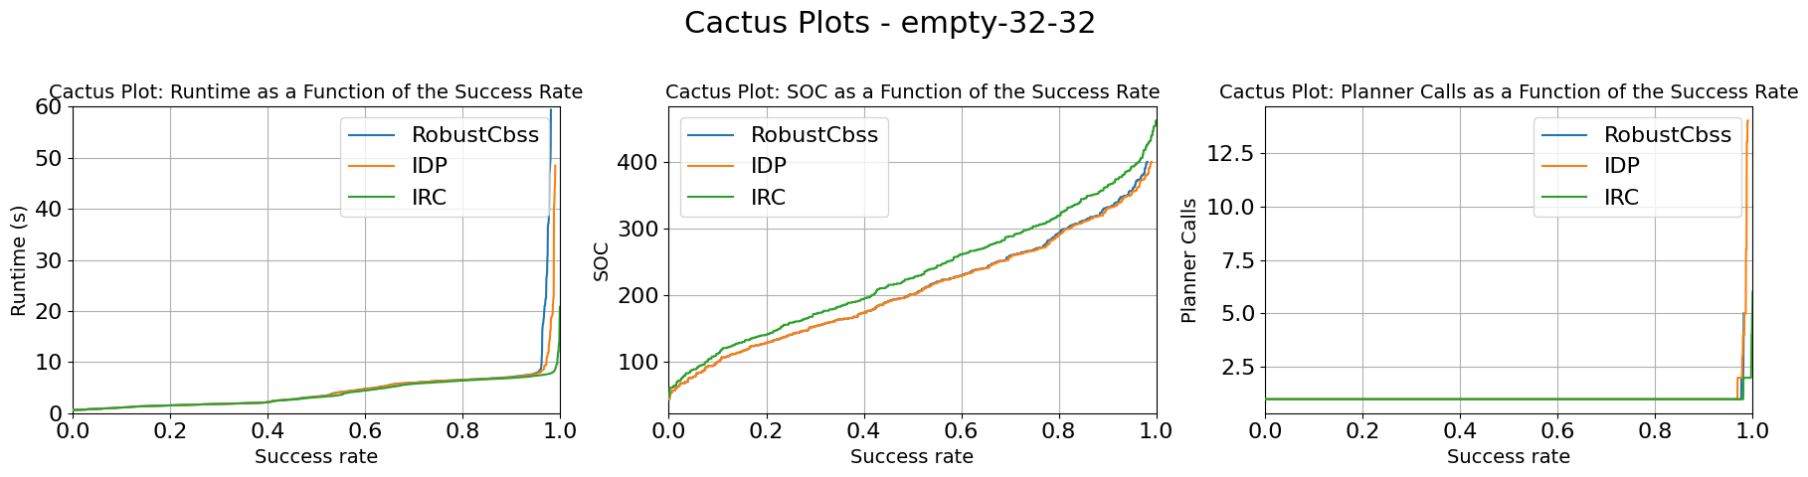
Empty-32-32 32X32

Slide 22
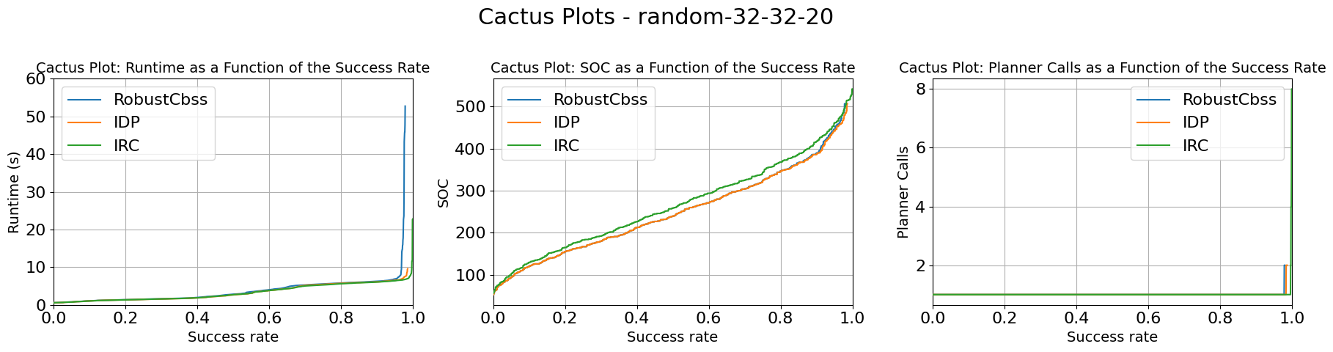
Random-32-32-20 32X32

Slide 23
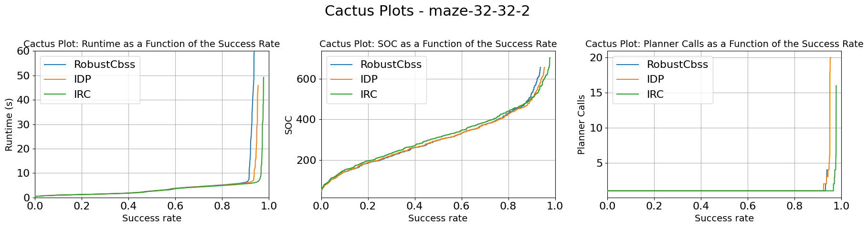
Maze-32-32-2 32X32

Slide 24
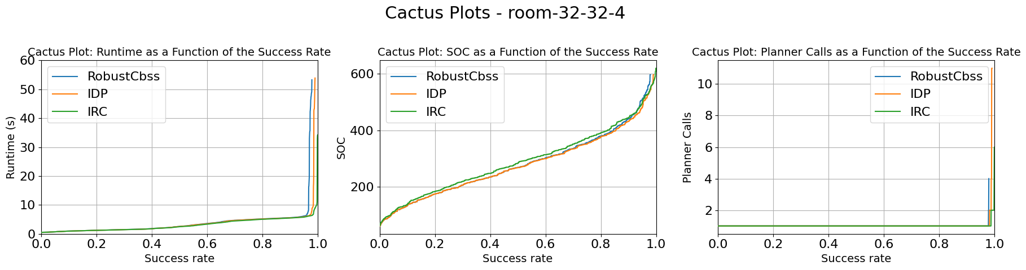
Room-32-32-4 32X32

Slide 25
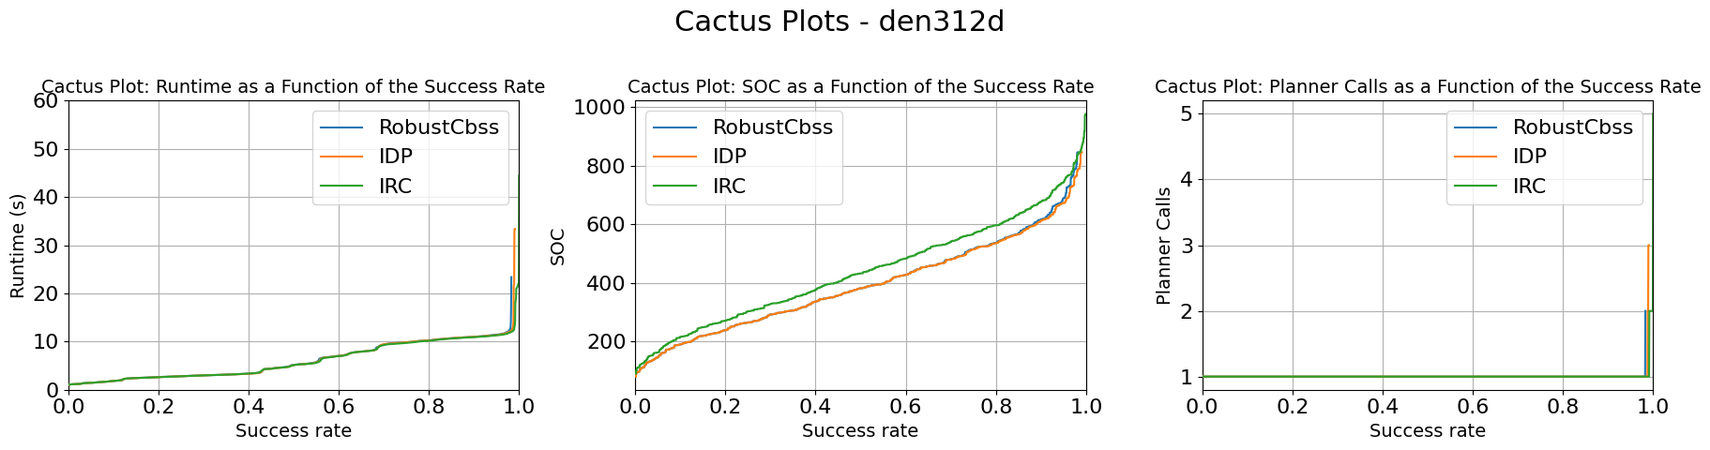
Den312d 81X65

Slide 26
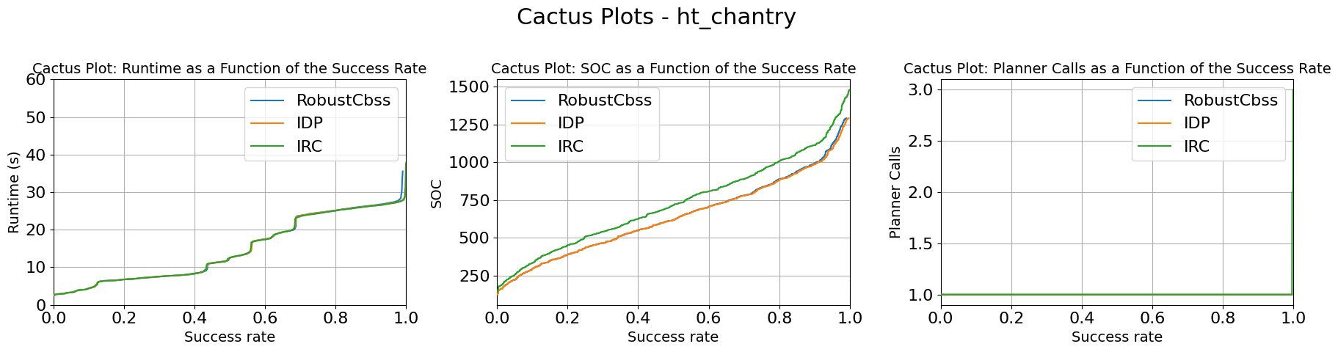
Ht_chantry 141X162

Slide 27
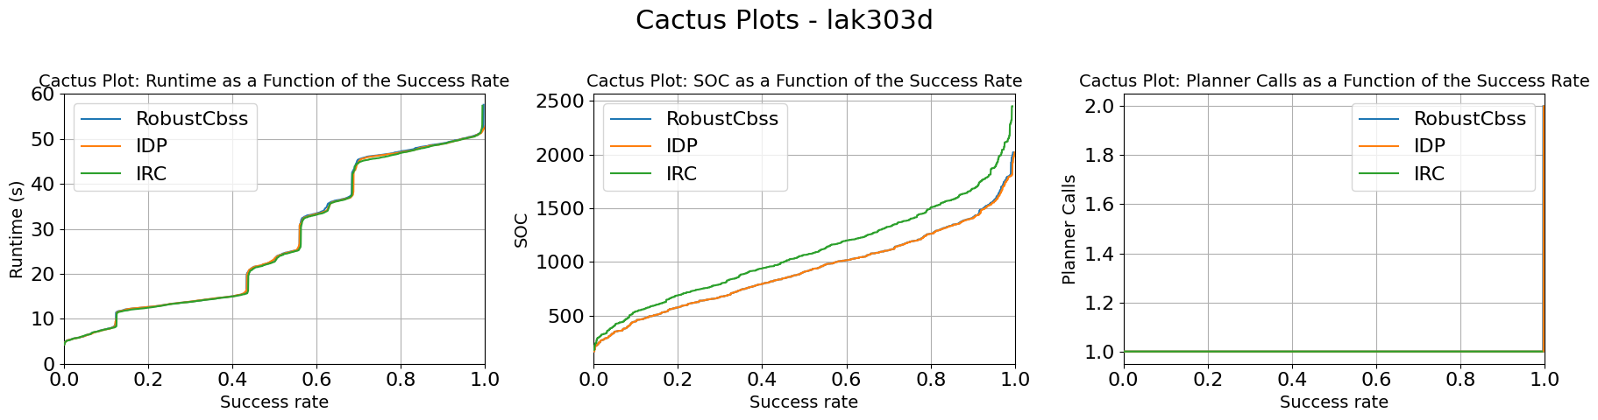
Lak303d 194X194

Slide 28
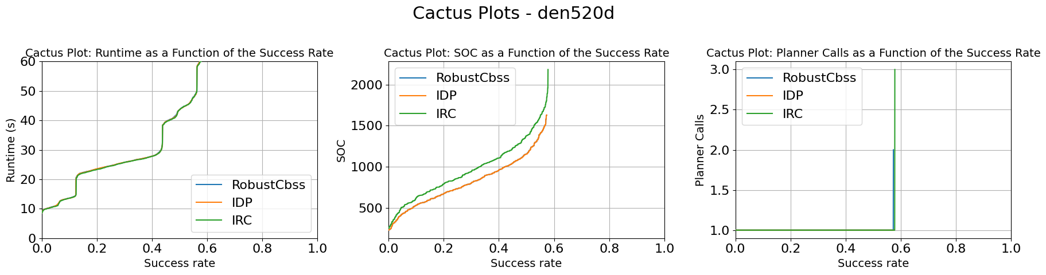
Den520d 257X256

